Slide 1
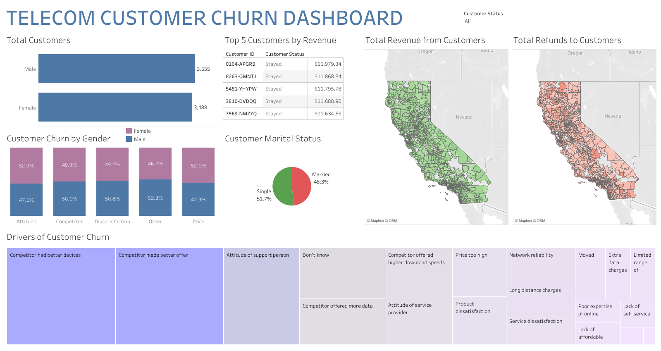

Slide 2
Abstract
I performed a customer churn analysis on a fictional telecommunications company.
The company provides internet services to 7,043 customers in California.
The datasets include the following details about its customers:
Demographics
Location
Services
Current status
I cleaned the tables using the Power Query editor.
I created a relational data model using Power Pivot.
I exported the cleaned tables to Tableau to conduct my analysis.

Slide 3
Data-Cleaning Strategy
I had a simple data-cleaning strategy for this project.
There were only two tables with one related column.
Both tables were already cleaned for the most part.
My strategy only focused on the “telecom_customer_churn” table.
I replaced the blank entries on the customer churn table with “N/A” values.
I converted all revenue metrics to currency data types.
I changed the “Married” column to “Marital Status.”
I replaced “Yes” values with “married.”
I replaced “No” values with “single.”

Slide 4
Key Questions
How many customers joined the company during the last quarter?
Is the company losing high-value customers? If so, how can they retain them?
What is the customer profile for a customer that churned, joined, and stayed?
What seem to be the key drivers of customer churn?

Slide 5
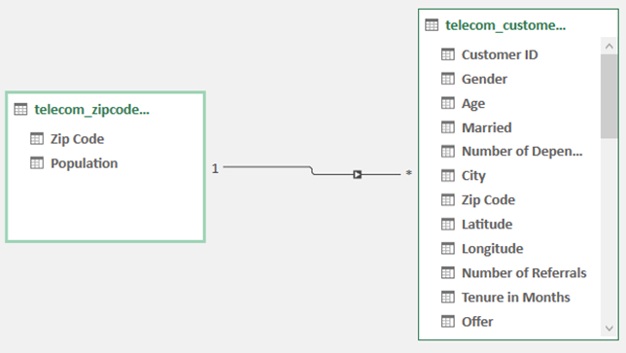
Data Model

Slide 6
Business Insights
The business had an almost uniform distribution of male and female employees.
There were 3,555 male employees and 3,488 female employees.
The business is not losing high-value customers.
The top 5 customers that drove the most revenue for the company stayed.

Slide 7
Customer Profile Insights
Churned
Churned customers were mostly single (64.2%) compared to married customers (35.8%)
Churned customers brought in revenue from many California zip codes.
These zip codes were heavily concentrated near the Pacific Coast.
Churned customers also wanted refunds from many California zip codes.
These zip codes were heavily concentrated near the Pacific Coast.
Joined
Joined customers were mostly single (81.5%) compared to married (18.5%).
Joined customers did not bring in that much revenue across California.
Joined customers did not want that many refunds across California.
Stayed
Stayed customers were mostly married (56.1%) compared to single (43.9%).
Stayed customers brought in revenue from almost all California zip codes.
These zip codes were heavily concentrated near central California.
Stayed customers also wanted refunds from almost all California zip codes.
The zip codes were heavily concentrated near central California.

Slide 8
Customer Churn Insights
The reasons for customers churning were about evenly distributed.
These are the top two drivers of customer churn:
Competitors had better devices.
Competitor made a better offer.

Slide 9
Recommendations
Concentrate marketing campaigns on the top 5 customers.
These customers are valuable because they generated the most revenue for the company.
Concentrate marketing campaigns near the 92027 zip code.
Customers generated the most revenue in this area of California.
Concentrate marketing campaigns on single customers.
These customers churned the most, so they must be the focal point of the marketing strategy.
Maintain good relationships with married customers.
These are the most loyal customers because they stayed with the company.
Invest in more technological innovations for the company.
A technological breakthrough in telecommunications may help get an edge in the market.

